Slide 1

The 2015 Health and Physical Education Curriculum Overview for Educators
Notes:
***These slides can be modified or adapted to your local school or board context. They are intended to be used in conjunction with the Toolkit Guide.

Slide 2
This session will
1
Provide an overview of the updated curriculum’s development process, content and key changes
2
Explore the curriculum and additional resources
3
Help you plan instruction, assessment and evaluation
4
Support you to have successful conversations with parents
Notes:
Speaker’s Notes
As you know, implementation of the updated Health and Physical Education (HPE) Curriculum is mandatory beginning in September 2015. This slide deck is intended for school leaders to lead discussions and provide a general overview for educators, and other school staff of the updated curriculum and to provide a starting point for planning and implementation and communicating with parents about the curriculum.
At the end of the presentation you will have a better understanding of the key changes. As well, you will have the information necessary to address some of the questions and concerns that parents may raise.

Slide 3

Student Well-Being
Curriculum be current, relevant, age-appropriate, and reflect Ontario’s diversity
The success,
safety and well-being of students requires that:
Students have the knowledge and skills to make informed decisions about their health and well-being
Notes:
Speaker’s Notes
Ontario is committed to the success, safety and well-being of every student and child – that is why it’s important that Ontario’s curriculum is current, relevant and age-appropriate to support students in having the best information possible to make informed decisions about their health and well-being.
This curriculum supports and aligns with ministry and government policies, initiatives and resources including, Achieving Excellence – Ontario’s Renewed Vision for Education; the Ontario Leadership Framework, Safe Schools, Healthy Schools, Ontario’s Mental Health and Addictions Strategy; Ontario’s Equity and Inclusive Education Strategy; Ontario’s Parent Engagement Policy, Stepping Stones, and Ontario’s First Nation, Métis and Inuit Policy Framework.
Additional Information:
The Health and Physical Education Curriculum supports and aligns with many provincial initiatives and strategies including Ontario’s Equity and Inclusive Education Strategy and Parent Engagement Policy. Further information for planning can be found starting on page 67 of the 1-8 document and page 72 of the 9-12 document.
In support of equity and inclusive education, in the front matter of both the 1-8 and 9-12 documents under roles of teachers we see the following statement: To increase their comfort level and their skills in teaching health and physical education and to ensure effective delivery of the curriculum, teachers should reflect on their own attitudes, biases, and values with respect to the topics they are teaching and seek out current resources, mentors and professional development and training opportunities when necessary (p. 15).

Slide 4
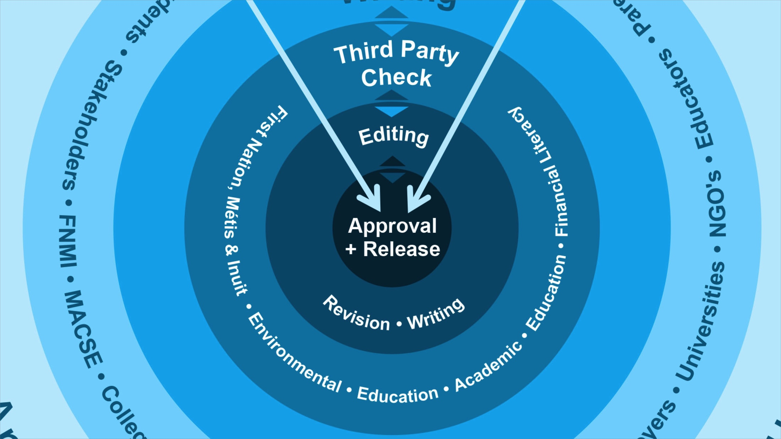
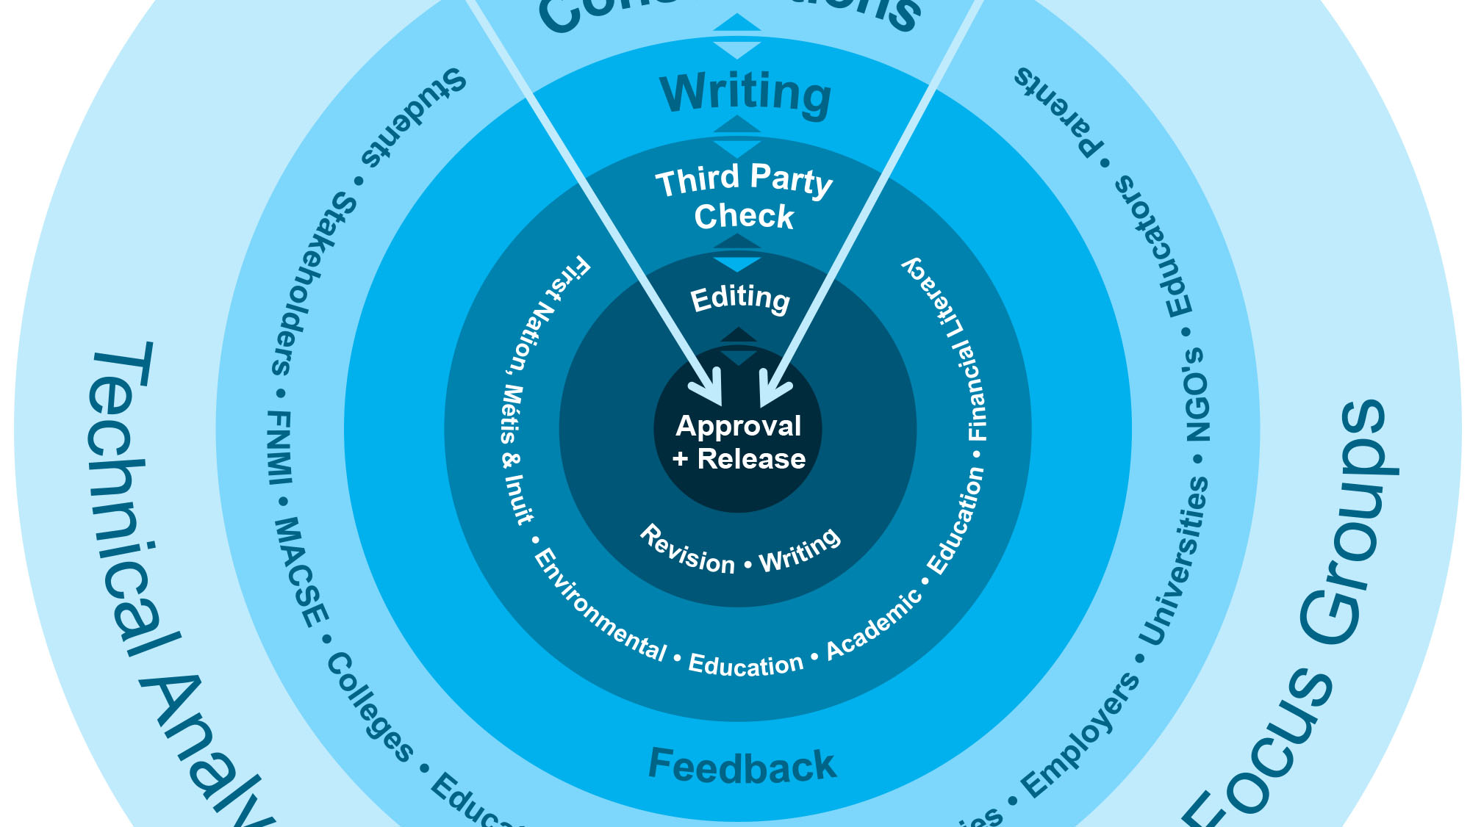
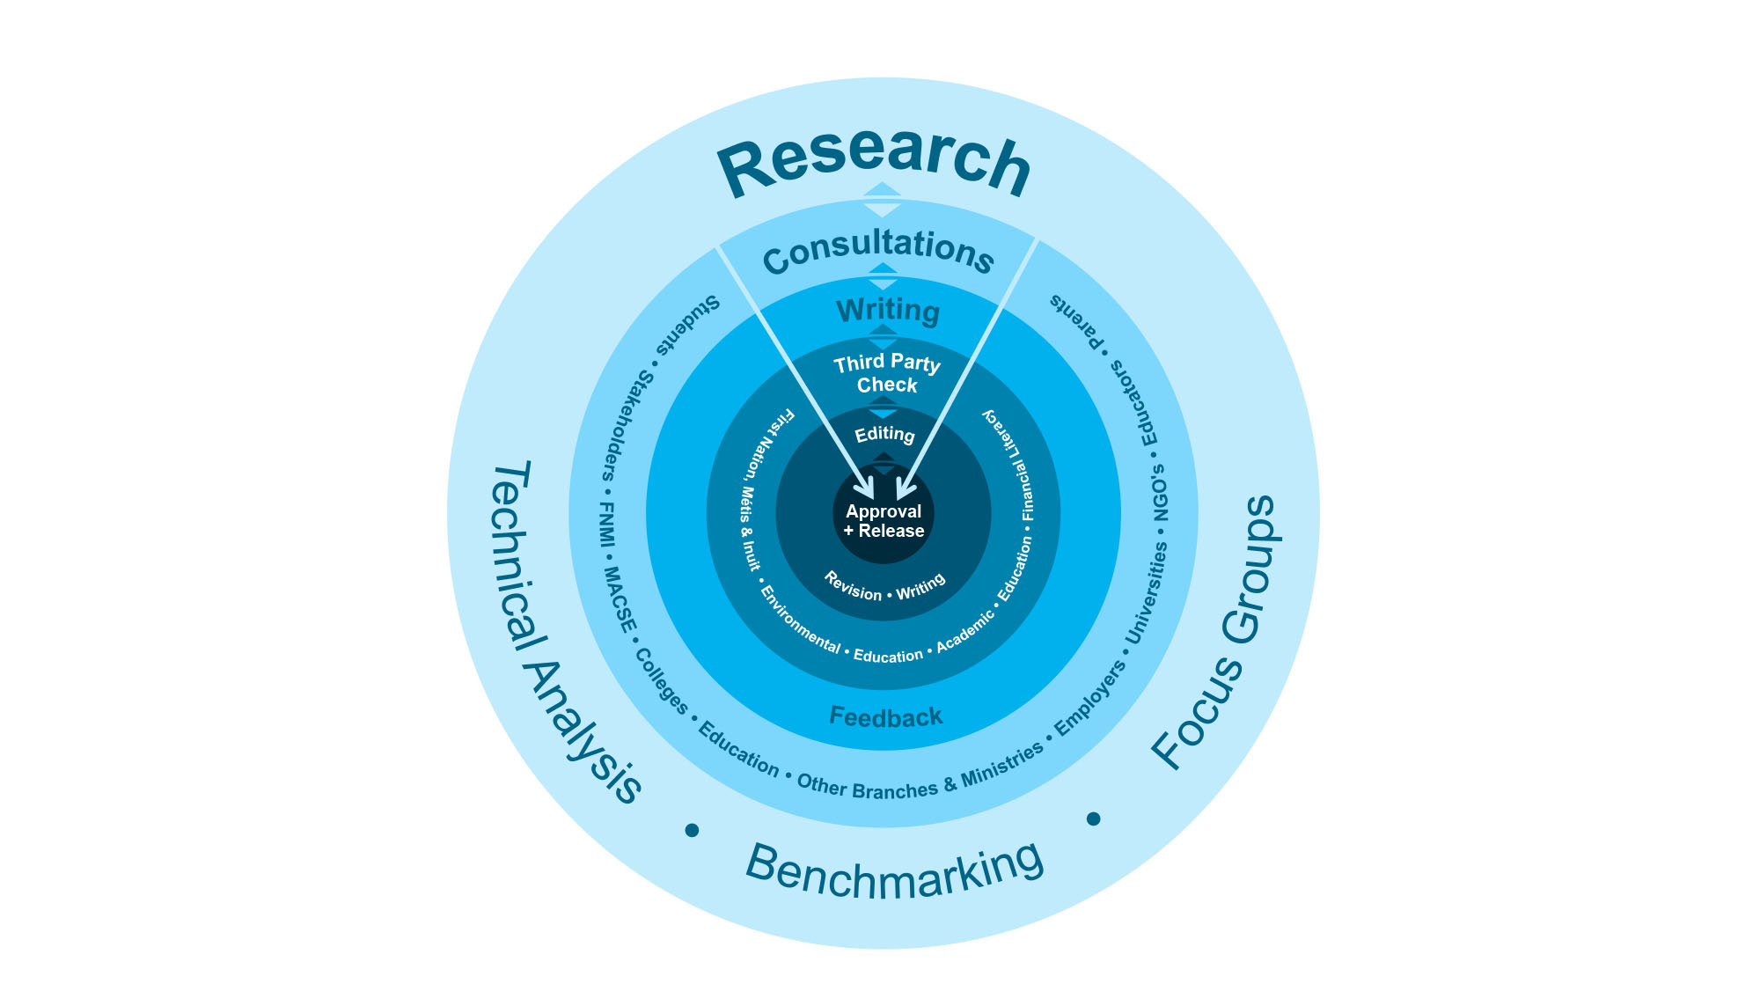
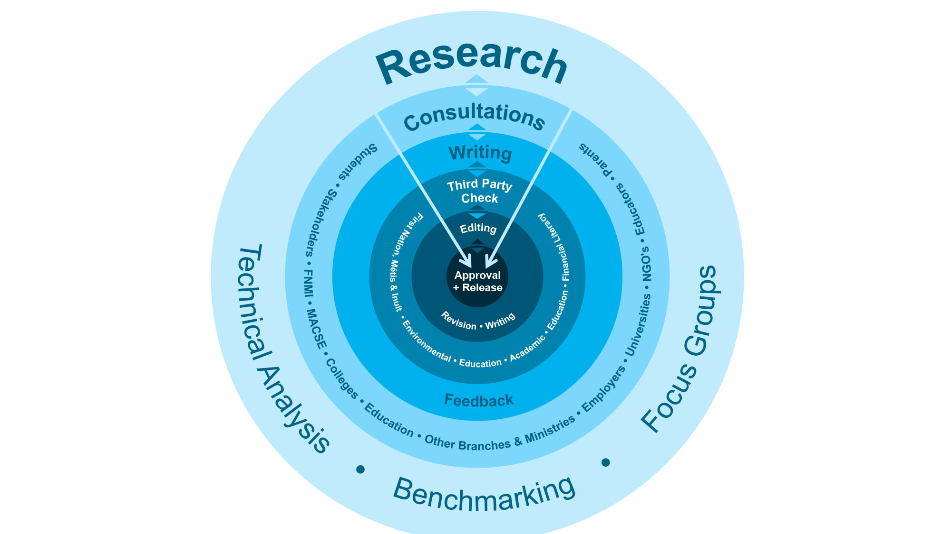
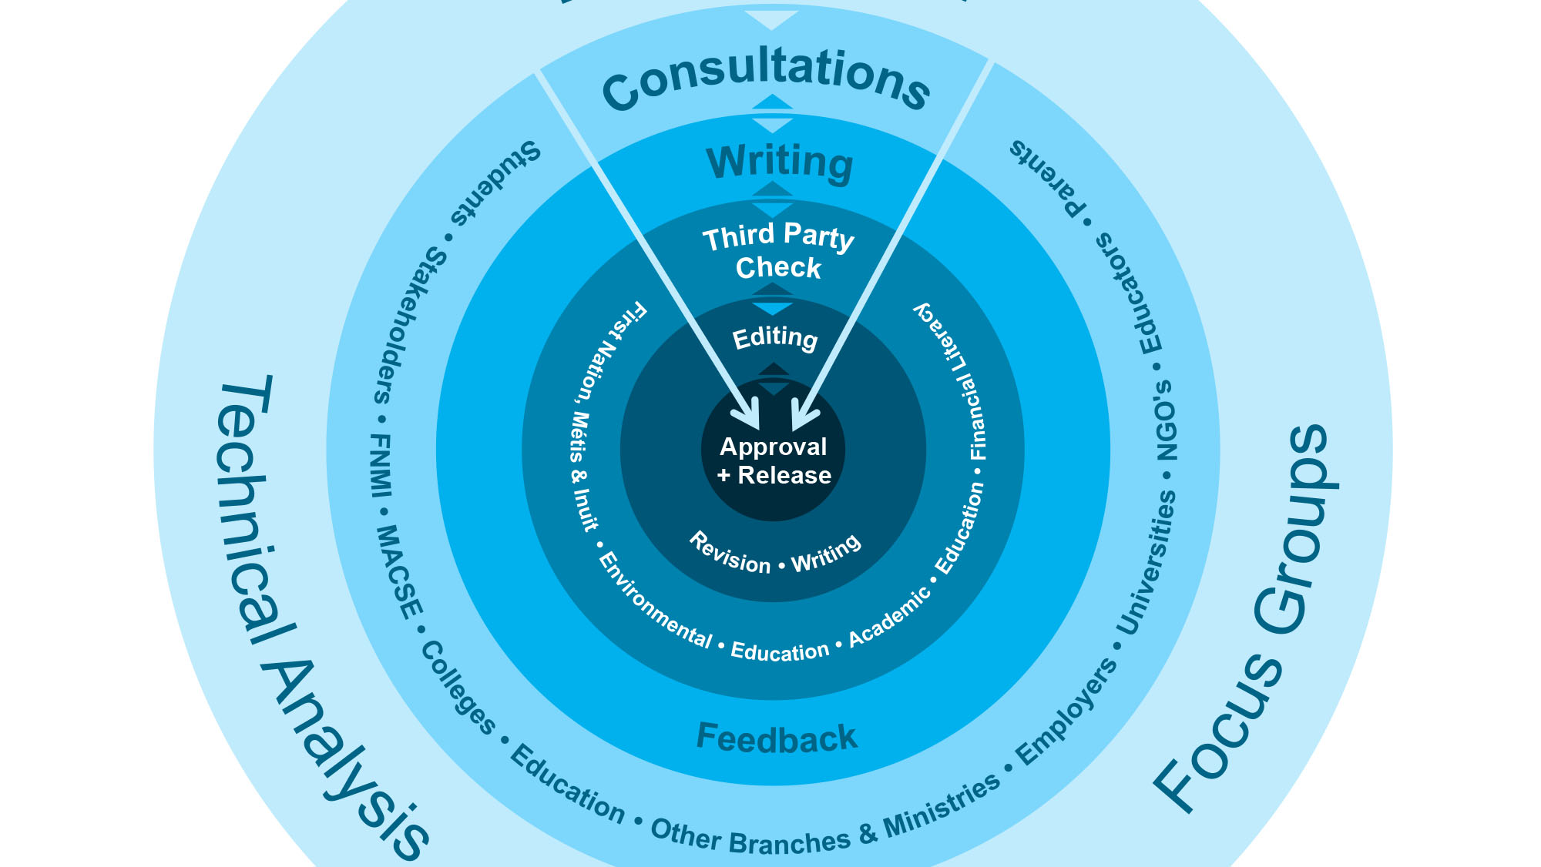
Curriculum Development Process
Notes:
Speaker’s Notes
All Ontario curriculum is based on research and extensive consultation. The implementation of the curriculum is mandatory in Ontario’s Public, Catholic publicly funded education systems.
The current curriculum review process is a comprehensive one that builds on the quality curriculum and is in place to help ensure that the curriculum remains current and relevant and that there is coherence from Kindergarten through Grade 12.
Extensive consultation occurred with teachers, principals, school board staff, subject experts, education stakeholders, parents and students at a variety of stages throughout the process.
Thousands of people have been involved in the review and development of the 2015 Health and Physical Education curriculum – educators, students, parents, public health, stakeholders, universities/faculties of education and a wide range of experts.

Slide 5
Vision of HPE
The revised health and physical education curriculum is based on the vision that the knowledge and skills students acquire in the program will benefit them throughout their lives and enable them to thrive in an ever-changing world by helping them to develop physical and health literacy as well as the comprehension, capacity, and commitment they will need to lead healthy, active lives and promote healthy, active living.
Notes:
Speaker’s Notes
The vision for Health and Physical Education promotes the development of skills that will help children develop a good understanding of themselves and become more resilient. The aim is that they will develop the knowledge and competence to participate in a wide range of activities that will enable them to enjoy being active and healthy throughout their lives.
Students develop the knowledge and skills to navigate their ever-changing world. The aim is for students to THRIVE – physically, emotionally and spiritually – in a safe, active and inclusive environment.
Additional Information:
The vision and goals of the HPE can be found on Page 6 of both the 1-8 and 9-12 documents.

Slide 6
Health and Physical Education Fundamental Principles
School, Family, and Community Support
Physical Activity as the Vehicle for Learning
Physical and Emotional Safety
Student-Centred, Skill-Based Learning
Balanced, Integrated Learning With Relevance to Students’ Lives
Notes:
Speaker’s Notes
The revised HPE curriculum is founded on the following principles. An effective program that reflects these principles will help our diverse students to learn and to thrive in our schools. Educators are encouraged to reflect on an ongoing basis about how these principles are evident in their teaching and classroom practices and resources.
Additional Information:
Detailed explanation of the fundamental principles can be found on page 9 of both the 1-8 and 9-12 document and reflective questions can be found in the Program Planning section.
School, Family, and Community Support: Students are most successful when they see the concepts they are learning in Health and Physical Education reflected and reinforced in their families and in their communities. These strong partnerships make students more likely to adopt healthy living skills and practices and maintain them throughout their lives.
Physical Activity as the Vehicle for Learning: Physical Activity offers students a unique opportunity to learn kinaesthetically. They learn about healthy living primarily by doing. In this way, they learn about movement, their bodies and they develop skills that will contribute to lifelong health and well-being.
Physical and Emotional Safety: Students learn best in an environment that is physically and emotionally safe. It is important that teachers create such an environment by emphasizing the importance of safety in all physical activity, treating students with respect, being sensitive to individual differences and providing an inclusive learning environment that respects diversity.
Student-Centred, Skill-Based Learning: Learning in health and physical education should be directly connected to the needs and abilities of the individual student. In order to reach their full potential, students need to receive progressive instruction, timely feedback and numerous opportunities to practice, reflect and learn.
Balanced, Integrated Learning With Relevance to Students’ Lives: Health and Physical Education is balanced in that it addressed the physical, cognitive, psychological, social and spiritual needs of the students, with connections being made between all aspects of the program in an integrated way. It should be highly relevant to the students’ present and future needs and connected authentically to their global, technologically rich and ever-changing worlds.

Slide 7
Key Change: Living Skills
“
The 21st century is quite different than the 20th in the capabilities people need for work, citizenship, and self-actualization. Twenty-first century skills are different than 20th century skills primarily due to the emergence of very sophisticated information and communications technologies.
“
(Chris Dede, “Comparing Frameworks for 21st Century Skills,” July 2009)
Notes:
Speaker’s Notes
The HPE curriculum provides a unique setting for students to develop living skills, which they will need as 21st century learners – skills to understand themselves, cope with challenges and change, get along with others, communicate and think critically and creatively. Living skills are embedded throughout the revised HPE curriculum in a more direct way than the previous curriculum.

Slide 8
Key Change: Living Skills
Students are learning:
self-awareness, adaptive skills and coping strategies to foster resilience, improved mental health and well-being
communication and collaboration skills
problem-solving, critical and creative thinking skills
Notes:
Speaker’s Notes
Examples of living skills are provided in every grade to show what this learning may look like in an age-appropriate way, within each of the strands. Tags are provided on curriculum expectations to highlight where explicit teaching of living skills may be integrated with learning in all parts of the curriculum. Educators help foster the development of problem-solving, critical and creative thinking, communication, self-awareness and adaptive skills, resilience, collaboration, and coping by integrating living skills into the instruction of all aspects of the curriculum.

Slide 9
Key Change: Healthy Relationships and Consent
“
“
Consent is about communication and respect. Communication leads to better relationships with friends, peers, family and romantic partners.
Ministry of Education, Quick Facts for Parents: Learning about Healthy Relationships and Consent, 2015
Notes:
Speaker’s Notes
The need to enhance learning about consent was raised by parents and is supported by research.
Additional Information:
Teachers are encouraged to review the Quick Facts for Parents: Learning about Healthy Relationships and Consent document for more information.

Slide 10
Key Change: Healthy Relationships and Consent
Young children learn:
Refusal skills and to stand up for themselves
To listen to others and show respect
To take responsibility for not causing harm to others in age-appropriate settings such as at play or in the schoolyard
Notes:
Speaker’s Notes/Script
Research suggests that understanding the concept of consent and developing skills for healthy relationships should start early. The foundation for understanding consent is linked closely to skills for healthy relationships.
Young children learn:
Refusal skills and to stand up for themselves
To listen to others, and show respect
To take responsibility for not causing harm to others in age-appropriate settings such as at play or in the school yard.

Slide 11
Key Change: Healthy Relationships and Consent
Older students learn:
What respect, healthy relationships and consent “look like”
The legal, social and emotional consequences of not understanding and paying attention to consent
How to report issues and how to get help from a caring adult or through community resources (e.g., police, doctors, public health units)
That both people in a relationship need to be actively involved in giving consent in an ongoing way
Notes:
Speaker’s Notes
As children grow, their understanding of consent needs to grow too.
Older students are learning about what respect, healthy relationships and consent ‘looks like’, and the consequences of not paying attention to consent.
These skills will help them handle different situations and relationships, which is highly personal and can be complicated.
Older students learn about:
What respect, healthy relationships and consent “look like”
The legal, social and emotional consequences of not understanding and paying attention to consent
How to report issues and how to get help from a caring adult or through community resources (e.g., police, doctors, public health units)
That both people in a relationship need to be actively involved in giving consent in an ongoing way

Slide 12

Key Change: Online Safety / Risks of Sexting
45%
of students access the internet using a smart phone.
25%
of Grade 4 students own their own phone
14%
of grade 11 students with cell phones say they have sexted, and
31%
of students report being threatened online.
51%
of students want to learn how to tell if online information is true
4 8%
of students will pretend to be older to join an age-restricted website
Source:
Young Canadians in a Wired World: Phase III Study, Cyberbullying: Dealing with Online Meaness and Threats (2014), available at http://mediasmarts.ca/sites/mediasmarts/files/pdfs/publication-report/full/YCWWIII_Cyberbullying_FullReport.pdf
Notes:
Speaker’s Notes:
Our digital and interconnected world has endless positive possibilities and opportunities for learning, connecting, communicating and collaborating. At the same time, students at all grade levels need to be aware of potential online risks.
The HPE curriculum helps children and youth develop skills for online safety by learning about things such as:
Safe and respectful use of technology
Social, emotional and legal implications of online behaviours such as sexting
Potential risks of sexting on relationships and future employment.
Additional Information:
For more information, see Quick Facts for Parents: Learning about Online Safety Including the Risks of Sexting www.edu.gov.on.ca/eng/curriculum/elementary/HPEonline.pdf

Slide 13
Key Change: Online Safety / Risks of Sexting
Students are learning:
Safe and respectful use of technology
Social, emotional and legal implications of online behaviours such as sexting and online bullying
Potential risks of sexting on relationships and future employment.
When they need to ask for help, and when they can try to solve a problem on their own.
Source:
Young Canadians in a Wired World: Phase III Study, Cyberbullying: Dealing with Online Meaness and Threats (2014), available at http://mediasmarts.ca/sites/mediasmarts/files/pdfs/publication-report/full/YCWWIII_Cyberbullying_FullReport.pdf
Notes:
Speaker’s Notes:
Our digital and interconnected world has endless positive possibilities and opportunities for learning, connecting, communicating and collaborating. At the same time, students at all grade levels need to be aware of potential online risks.
The HPE curriculum helps children and youth develop skills for online safety by learning about things such as:
Safe and respectful use of technology
Social, emotional and legal implications of online behaviours such as sexting
Potential risks of sexting on relationships and future employment.
Additional Information:
For more information, see Quick Facts for Parents: Learning about Online Safety Including the Risks of Sexting www.edu.gov.on.ca/eng/curriculum/elementary/HPEonline.pdf

Slide 14
Key Change: Respect for Diversity
“
“
…all students should see themselves in the curriculum, their physical surroundings and the broader environment so they can feel empowered and engaged in and empowered by their learning experiences.
Ministry of Education, The Ontario Curriculum, Grades 1-8: Health and Physical Education, 2015 (revised), p. 67
Notes:
Speaker’s Notes
Ontario is the most diverse province in Canada and our diversity is one of our greatest strengths. In an inclusive and equitable education system, race, sexual orientation, gender identity, gender expression, socio-economic status, or any other factor, should not prevent students from achieving ambitious outcomes.
Our schools have demonstrated leadership in fostering safe, inclusive and accepting school climates and cultures to support the success and well-being of all students. The updated HPE curriculum is implemented within this context.
All students see themselves reflected in their school environment and in what they’re learning at school. School staff can reflect and meet the needs of their diverse students by taking into account the backgrounds, experiences, identities, life circumstances, interests, aptitudes and unique learning needs.
Examples of Ontario’s diversity:
27 % of Ontario students are born outside of Canada (OECD, Strong Performers and Successful Reformers in Education, 2011);
Ontarians have reported more than 200 languages as “mother tongue” (2006 Census of Canada, Statistics Canada);
Most classrooms in Canada will likely have at least one or more students who identify as lesbian, gay, bisexual, trans, or questioning (Sexual Health Education in the Schools, Questions and Answers, Updated Ontario 2015 version);
By the year 2031, diverse faith communities will continue to increase. This will include Islam, Hinduism, Buddhism, and Judaism including a growing number of individuals without a religious affiliation (International Migration Outlook, 2012, Statistics Canada National Household Survey, 2011).

Slide 15
Key Change: Respect for Diversity
Students are learning:
About what makes themselves and their families unique
To respect differences and treat all peers with respect
To celebrate diversity
Respond to bullying, stereotypes and homophobia
Notes:
Speaker’s Notes
The HPE curriculum has been updated to be more inclusive of the needs and experiences of all students, and to better reflect the diversity of the Ontario population.
It provides opportunities for students to learn about what makes themselves and their families unique, to respect differences, treat others with respect and appreciate diversity.
It also teaches students how to respond to bullying, harassment and discrimination. This may include actions based on homophobia, biphobia, transphobia, racism, sexism, faith as an “ism”, etc. Through this learning, students develop a positive self-concept and help create an inclusive school and society.
Additional Information:
Further information about preventing and addressing bullying, harassment and discrimination (including the roles and responsibilities of teachers, school staff and principals/vice-principals) can be found through professional learning modules developed by the Ontario Education Services Corporation (OESC) to support safe, inclusive, accepting schools http://acceptingschools.oesc-cseo.org/en-ca/ (*there are French, Public and Catholic versions available through this website)

Slide 16

The curriculum includes:
Overall Expectations
Specific Expectations
Optional Examples and Prompts (sample teacher questions and student responses)
Notes:
Speaker’s Notes
Like all Ontario curriculum, the health and physical education curriculum has overall and specific expectations, which define the knowledge and skills students are expected to know and be able to demonstrate in each subject at each grade. The curriculum also includes optional prompts and examples.
It is important to note the optional prompts and sample responses are meant to show what conversation and topics could look like in a classroom, but these are not mandatory. They are not a script, but are included to help prompt thinking, guide planning and anticipate questions that could arise in class. Teachers should use their professional judgment in using the examples and sample questions as they develop their lessons.
Additional Information:
For clarity on prompts and examples of student responses refer to: page 20 in the 1-8 and page 25 in the 9-12 document
When playing slide show, click to see examples of overall expectations, specific expectations, examples and prompts

Slide 17
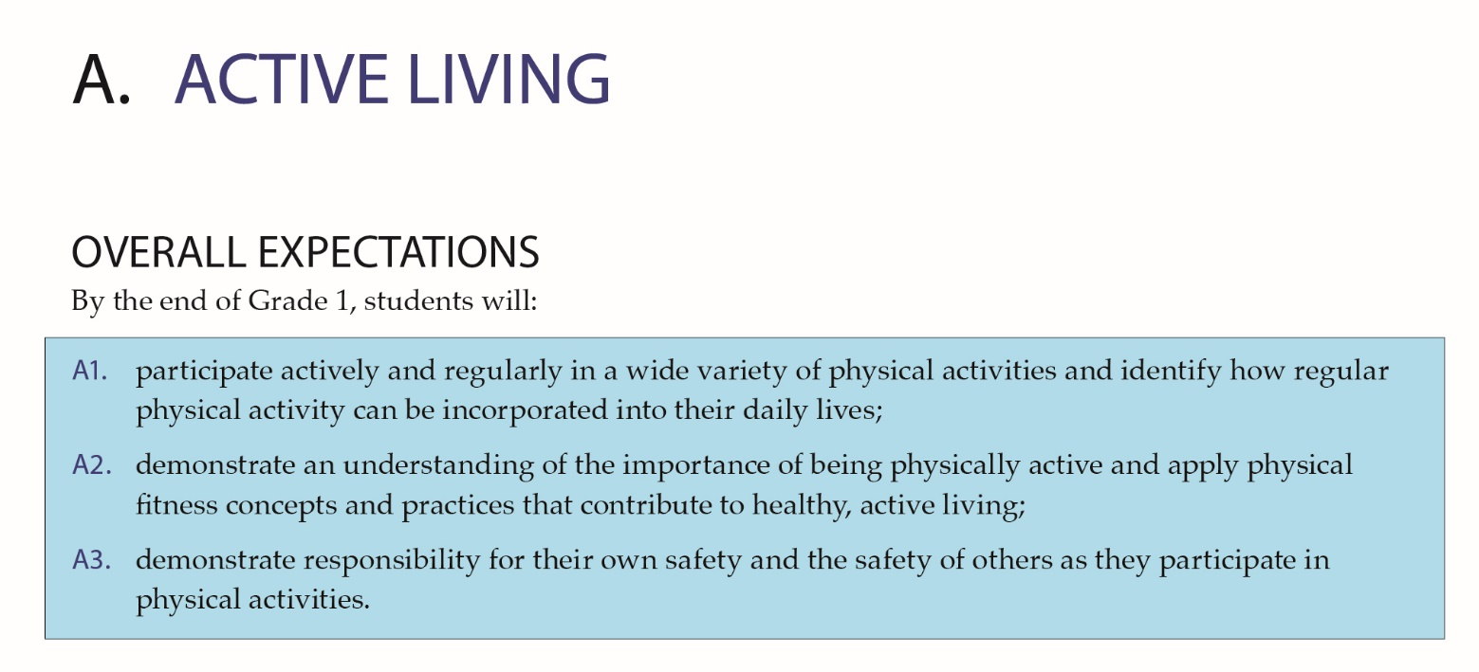
Notes:
Speaker’s Notes
Like all Ontario curriculum, the health and physical education curriculum has overall and specific expectations, which define the knowledge and skills students are expected to know and be able to demonstrate in each subject at each grade. The curriculum also includes optional prompts and examples.
It is important to note the optional prompts and sample responses are meant to show what conversation and topics could look like in a classroom, but these are not mandatory. They are not a script, but are included to help prompt thinking, guide planning and anticipate questions that could arise in class. Teachers should use their professional judgment in using the examples and sample questions as they develop their lessons.
Additional Information:
For clarity on prompts and examples of student responses refer to: page 20 in the 1-8 and page 25 in the 9-12 document
When playing slide show, click to see examples of overall expectations, specific expectations, examples and prompts

Slide 18
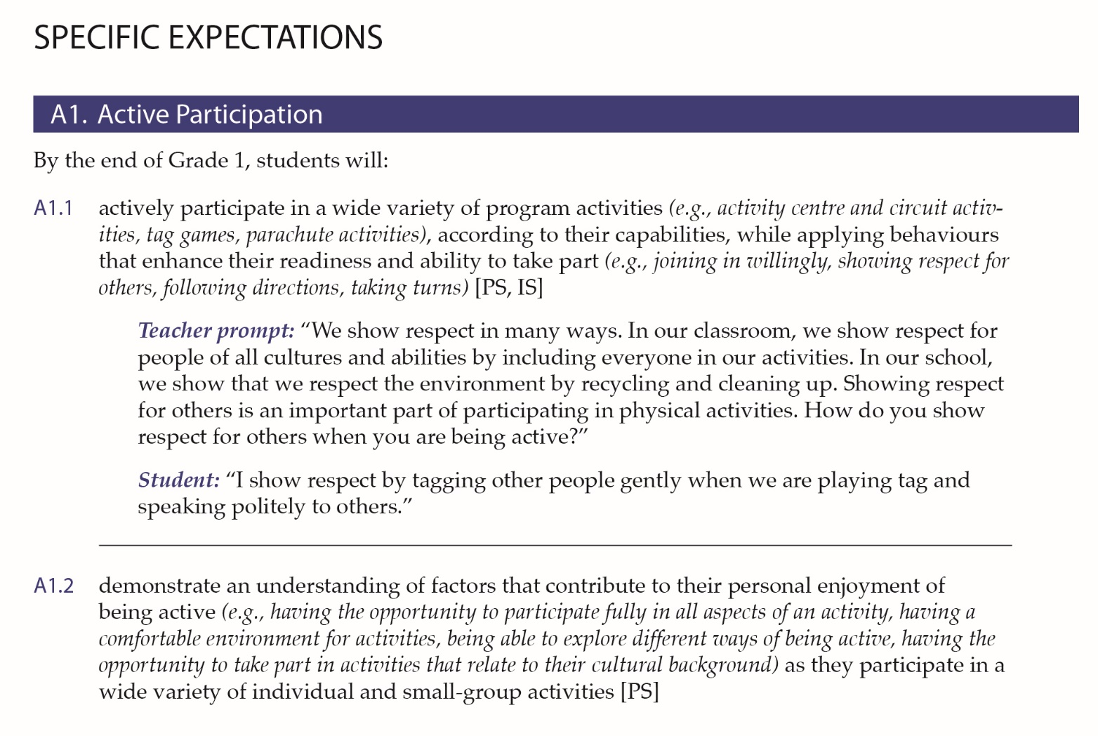
Notes:
Speaker’s Notes
Like all Ontario curriculum, the health and physical education curriculum has overall and specific expectations, which define the knowledge and skills students are expected to know and be able to demonstrate in each subject at each grade. The curriculum also includes optional prompts and examples.
It is important to note the optional prompts and sample responses are meant to show what conversation and topics could look like in a classroom, but these are not mandatory. They are not a script, but are included to help prompt thinking, guide planning and anticipate questions that could arise in class. Teachers should use their professional judgment in using the examples and sample questions as they develop their lessons.
Additional Information:
For clarity on prompts and examples of student responses refer to: page 20 in the 1-8 and page 25 in the 9-12 document
When playing slide show, click to see examples of overall expectations, specific expectations, examples and prompts

Slide 19
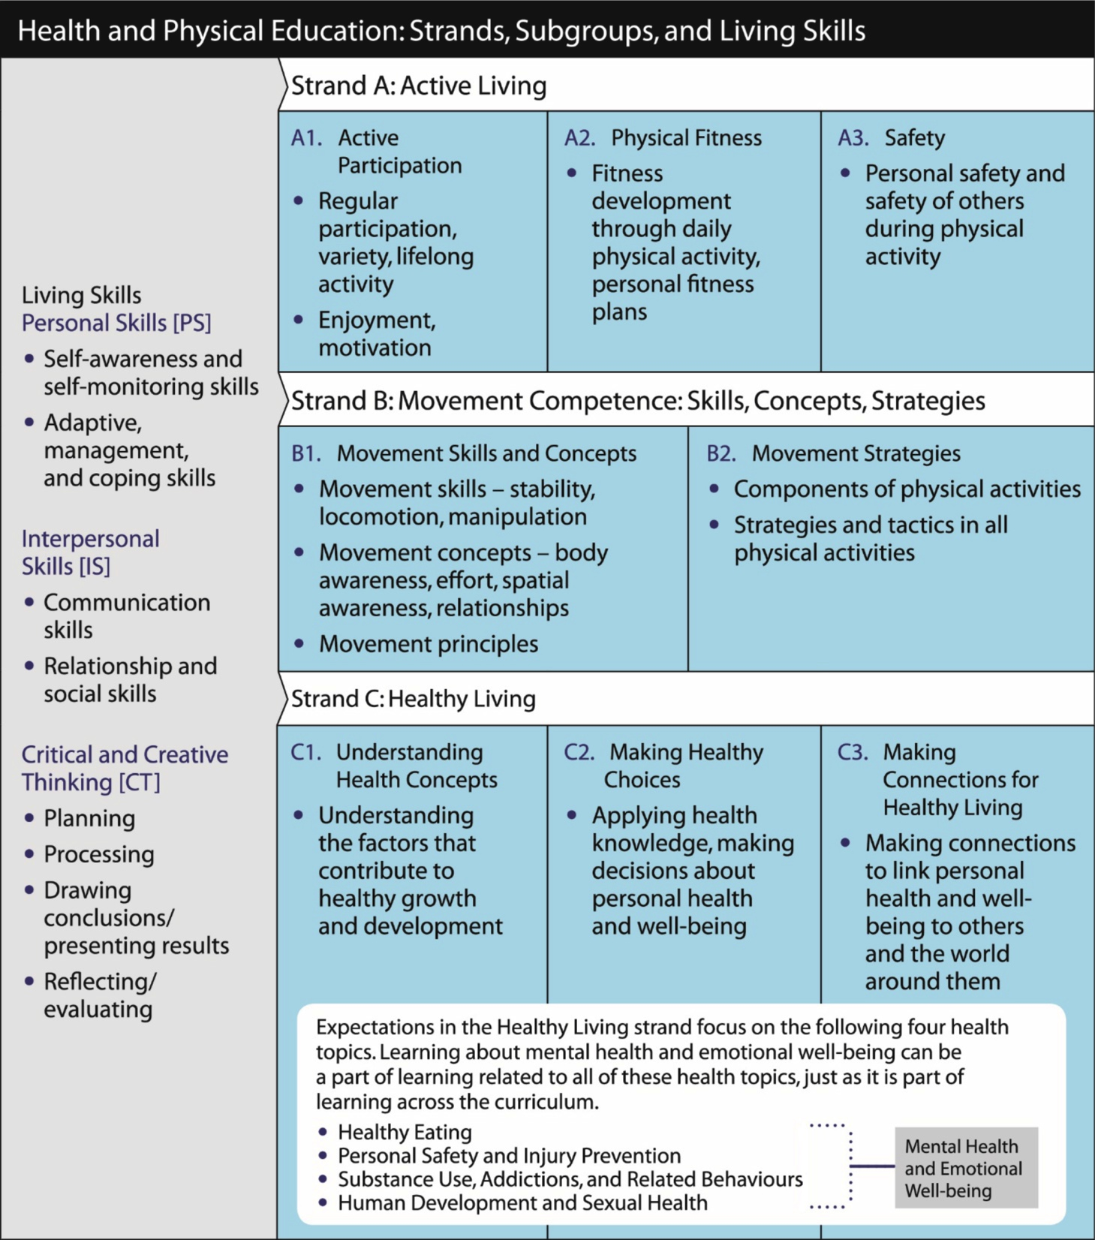

Strands and Living Skills
Notes:
Speaker’s Notes
The expectations for HPE are organized into three distinct but related strands – Active Living (Strand A), Movement Competence (Strand B) and Healthy Living (Strand C), which includes Human Development and Sexual Health. Living Skills (found in the grey column on the left) are to be integrated and taught in conjunction with the learning expectations, so that as students are achieving the expectations they are also developing Living Skills.
This chart shows the interrelationships among the various components. This structure remains consistent from the elementary curriculum into the Healthy and Active Living Education courses in grades 9 – 12.
Additional Information:
More information on the strands and Living Skills can be found on pages 21-26 of the elementary curriculum.
It is recommended that all educators familiarize themselves with the content of the Healthy Living Strand as that is the area where there have been the most questions from parents. See overview at the beginning of the curriculum – elementary, p. 34-39; secondary, p. 37-43.

Slide 20
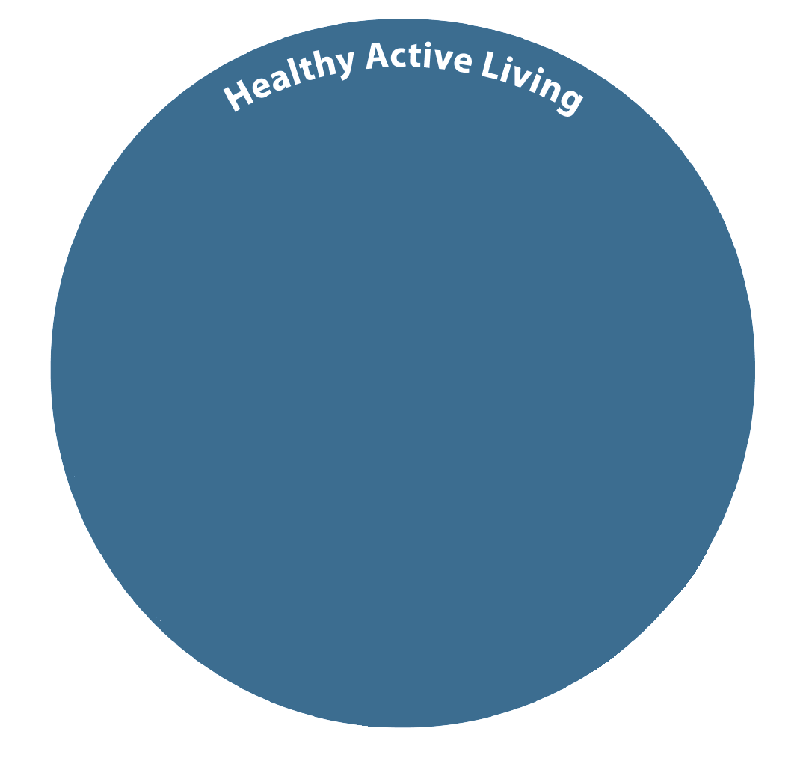

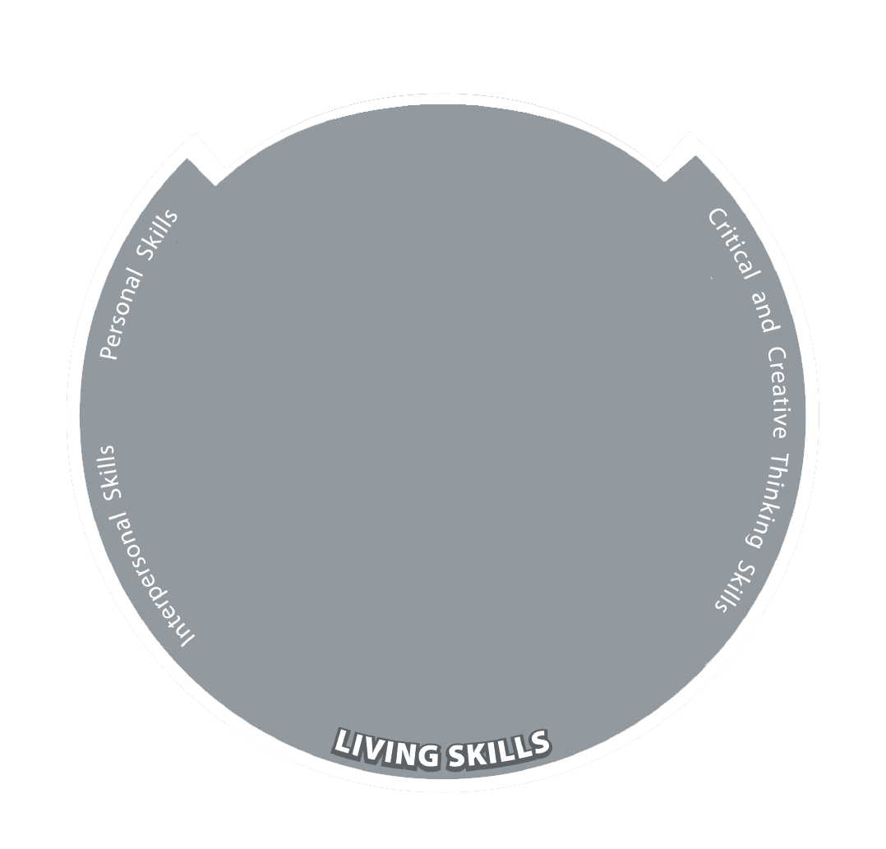
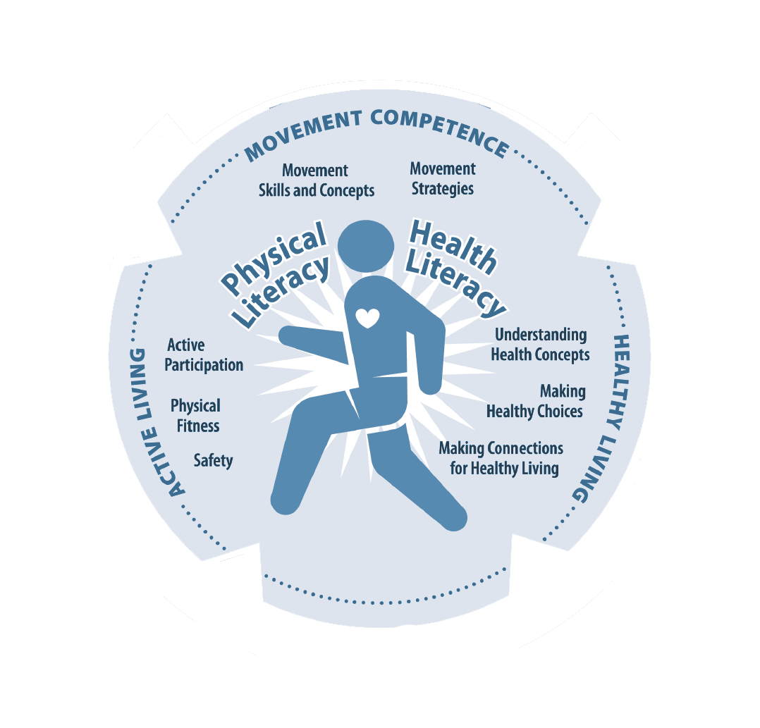

Strands and Living Skills
Notes:
Speaker’s Notes
This curriculum is student-centered and supports a holistic approach to health and physical education. The child is at the centre and the expectations in the strands of Active Living, Movement Competence and Healthy living are meant to meet their individual needs, strengthen their self-concept and help them develop physical and health literacy.
Skills are taught in context to promote the development of transferrable skills that can be applied in a variety of settings and activities.
The ultimate goal is to promote well-being by encouraging the development of skills and habits that will lead to lifelong healthy and active living.
Living skills are to be integrated into day-to-day instruction in all strands. These skills include: self-awareness, adaptive, management and coping skills, interpersonal skills and critical and creative thinking skills.

Slide 21
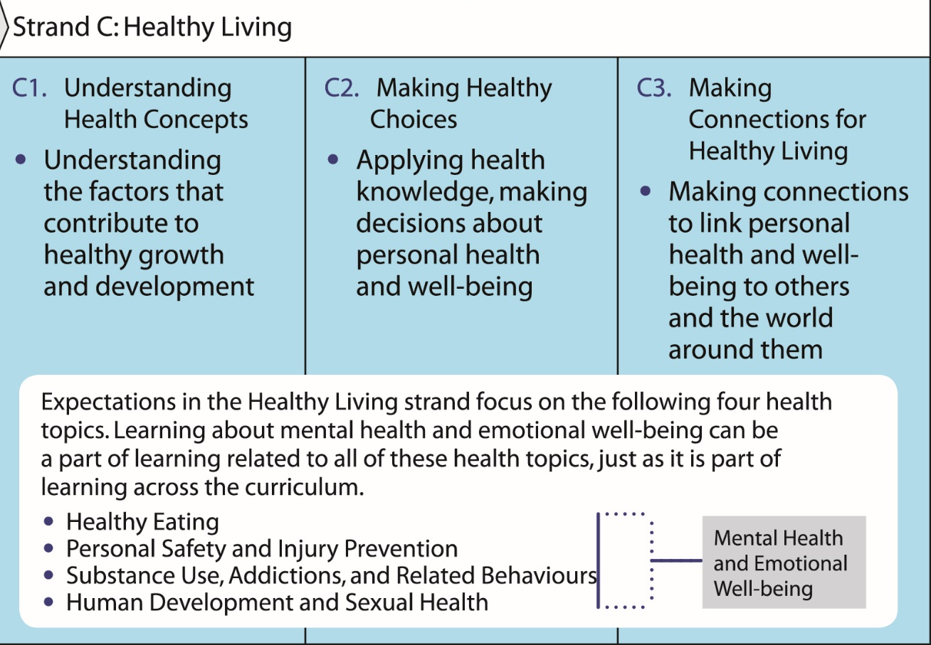
Healthy Living: A Closer Look
Notes:
Speaker’s Notes
The approach to Health Education has changed. The revised curriculum is not about memorizing health facts and diagrams.
Students are learning about things that are important to their safety, well-being and everyday lives. The curriculum is structured so that students learn to [C1] Understand Health Concepts related to healthy eating, safety and injury prevention, substance use and addictions as well as sexual health. They are learning to apply this knowledge to [C2] Make Healthy Choices as they are [C3] Making Connections between their health and well-being of others and the world around them.
Learning about mental health and emotional well-being is integrated throughout the Healthy Living strand and the entire curriculum, as mental health is intricately connected to all aspects of a student’s physical and emotional development. Increasing awareness and understanding of mental health and well-being also helps eliminate stigma related to mental illness and addictions.

Slide 22

Grades 1-3: Human Development and Sexual Health
Students are learning:
The names of body parts (including genitalia)
An initial understanding of how bodies work
Skills for healthy, respectful relationships with peers and families
Hygiene, oral health and stages of development
Emotional awareness and to get help if needed
Social and emotional health (e.g., getting along with others, recognizing their feelings, learning coping skills, etc.)
Notes:
Speaker’s Notes
In today’s complex and fast-paced world, there is much more that children and youth need to know to be safe and healthy. Human development and sexual health is one part of the overall health and well-being. It includes learning about healthy relationships, hygiene, reproductive health, identity, including gender identity, affection and pleasure, mental health, abstinence, contraception and disease prevention, sexual orientation, online safety, consent and much more.
There has been some misinformation and confusion among parents, community members, and in the media, with regards to what students will learn about in relation to human development and sexual health. Research has shown that many parents are open to the curriculum once they have information about what is actually being taught. The terminology used in the prompts and examples relating to Human Development and Sexual Health is factual and straightforward. Experts advise that this approach can help de-stigmatize concepts associated with sexuality.
The next three slides look specifically at the Human development and Sexual Health learning expectations to provide the facts about the intended learning in the curriculum.
Some things students in Grades 1, 2 and 3, are learning about include:
-The names of body parts (including genitalia)
-An initial understanding of how their bodies work
-Skills for healthy relationships with peers and families, like showing respect for others
-Their senses, hygiene, oral health and stages of development
-Their physical health is one part of overall health and well-being
-Being aware of their feelings and getting help if they need it
-Their social and emotional health (e.g., getting along with others, recognizing their feelings, learning coping skills).
Additional Information:
The contents of this slide were adapted from: A Parent’s Guide: Human Development and Sexual Health in the Health and Physical Education Curriculum, Grades 1-6 www.edu.gov.on.ca/eng/curriculum/elementary/HPEgrades1to6.pdf

Slide 23
Grades 4-6: Human Development and Sexual Health
Students are learning:
About the physical changes that occur during puberty
About the emotional and interpersonal changes and stresses that come with puberty
To understand reproductive and bodily processes
Notes:
Speaker’s Notes
There has been some misinformation and confusion among parents, community members, and in the media, with regards to what students will learn about in relation to human development and sexual health. Research has shown that many parents are open to the curriculum once they have information about what is actually being taught. The terminology used in the prompts and examples relating to Human Development and Sexual Health is factual and straightforward. Experts advise that this approach can help de-stigmatize concepts associated with sexuality.
In Junior Grades (Grades 4, 5, and 6), as students grow and develop, they start to understand the physical, emotional, social and cognitive changes they will experience at puberty. Learning about puberty in these grades includes:
The physical changes that occur during puberty
The emotional and interpersonal changes and stresses that come with puberty
Understanding reproduction and body processes
Learning more about healthy relationships and appropriate ways to respond to and challenge assumptions and stereotypes
This knowledge gives students the basis for positive mental health and well-being and introduces them to skills that they can build on as they grow. The learning focuses on students understanding themselves and knowing how this will help them in their relationships with other people. This includes relationships with other students and learning about relationships that may involve early romantic interest.
Additional Information:
An overview of the curriculum for Grades 4-6 can be found on pages 129-182 in the Health and Physical Education curriculum document. A concise overview of all expectations for Grades 1-8 can be found in the appendices on pages 222-225 of the document
Contents of this slide were adapted from: A Parent’s Guide: Human Development and Sexual Health in the Health and Physical Education Curriculum, Grades 1-6 http://www.edu.gov.on.ca/eng/curriculum/elementary/HPEgrades1to6.pdf

Slide 24
Grades 7-12: Human Development and Sexual Health
Students are learning about:
Identity, personal safety, decision making and relationships with peers, family and romantic partners
Delaying sexual activity
Preventing sexually transmitted infections and pregnancy
Factors that influence decisions (e.g., peers, media and information)
Resources related to sexual health such as public health services, community health agencies, reliable and accurate websites
Notes:
Speaker’s Notes
There has been some misinformation and confusion among parents, community members, and in the media, with regards to what students will learn about in relation to human development and sexual health. Research has shown that many parents are open to the curriculum once they have information about what is actually being taught. The terminology used in the prompts and examples relating to Human Development and Sexual Health is factual and straightforward. Experts advise that this approach can help de-stigmatize concepts associated with sexuality.
As students get older, become more independent and start broadening their relationships, what they need to learn about human development and sexual health deepens. They learn more about:
Themselves and others, their identity, peer, family and romantic relationships, personal safety and decision-making
Delaying sexual activity, preventing sexually transmitted infections, and pregnancy prevention
Factors that influence decisions such as peers, media, curiosity, and access to information
Sources of support and information related to sexual health such as public health services, community health agencies, reliable and accurate websites.
Additional Information:
Teachers of grade 7 and 8 can refer to pages 183-220 of the Health and Physical Education curriculum to view an overview of the learning in the intermediate division. A concise overview of all expectations for grades 1-8 can be found in the appendices on pages 222-225 of the document. Grade 9-12 can be found in the 9-12 document, pp. 201-205
The content of this slide was adapted from: A Parent Guide: Human Development and Sexual Health in the Health and Physical Education Curriculum, Grades 7-12. https://www.edu.gov.on.ca/eng/curriculum/elementary/HPEgrades7to12.pdf

Slide 25
Small Group Discussion
How can the appendices which provide comprehensive learning
summaries be used to support planning instruction?
How will the shift from teaching topics to a holistic approach to Health
Education impact your planning and instruction?
Discuss strategies for supporting students with special education needs.
What aspects of your teaching and instruction do you anticipate will
change, or stay the same?
Discuss how expanded examples, teacher prompts and student responses
in the curriculum can be used to anticipate student needs and plan instruction.
Notes:
Additional Information:
These sample small group discussion questions can be used to stimulate dialogue on the updated HPE curriculum’s key changes and on approaches to curriculum implementation.
If principals/vice-principals are presenting this to staff, this may be a logical break-out point for divisions etc.

Slide 26
Parent Concerns and Requests for Religious Accommodations
For parent questions, concerns, and requests for accommodations, consult with your principal, vice-principal, or board staff.
Review School Board Religious Accommodation Guideline and any related policies, protocols or procedures.
Meet parents one-on-one to discuss their questions and concerns.
Review Appendix on pp. 224-225 of Grades 1-8 HPE or pp. 204-205 of Grades 9-12 HPE and specific curriculum content related to questions and concerns.
Provide parents with the Ministry of Education’s Parent Guides.
Review the Parent Guide and curriculum together to build understanding.
Notes:
Speaker’s Notes
Parents are valued partners in their children’s education.
Parents may have questions or concerns about what their children are learning in school. Often, these questions and concerns can be addressed through open, respectful and ongoing dialogue. Showing the age-appropriate expectations in the updated HPE curriculum and providing factual information can often help alleviate parental questions and concerns.
If a parent considers their religious beliefs to be in conflict with components of the curriculum or classroom learning activities, they may request a religious accommodation. Requests should be discussed on an individual, case by case basis, taking into account board policies and individual circumstances.
Additional Information:
Teachers are encouraged to speak with their principal/vice-principal for guidance in relation requests for accommodation. Tips for responding to parent questions and concerns and addressing requests for accommodations are addressed in the Toolkit Guide.
In situations where concerns persist, principals/vice-principals are encouraged to keep in close communication with their supervisory officers. In particular, when requests for accommodation arise. Good record keeping is important.
Every school board must have a religious accommodation guideline in place to help address requests for religious accommodations. It is important for principals and vice-principals to be aware of their board guideline and any related policies, protocols or procedures. To support school boards in the development of their religious accommodation guidelines, the Ontario Education Services Corporation (OESC) developed Religious Accommodation Guideline templates. The templates provide further information and guidance related to religious accommodation and can be found at: www.oesc-cseo.org/English/Downloads/equityInclusivity/ReligiousAccomGuidelineEnglPublicV5-0.doc

Slide 27
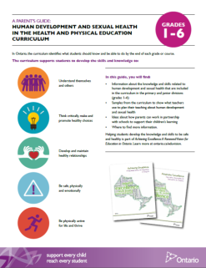
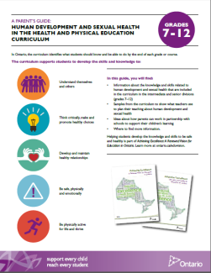


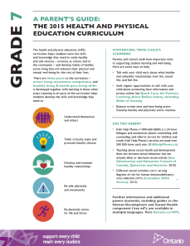
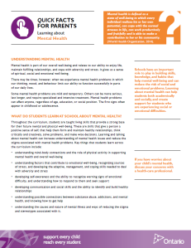
HPE Materials for Parents
Curriculum Guides and Overviews for Parents:
Grade-by-Grade Curriculum Overviews
Guide to Revised HPE Curriculum, Grades 1-12
Guides to Human Development and Sexual Health in the HPE Curriculum for Grades 1-6 and for Grades 7-12
Overview of Sexual Health Component (Ontario.ca\HPE)
Quick Facts for Parents – Learning About:
Healthy Relationships and Consent
Online Safety, including Risks of Sexting
Mental Health
Concussions
Staying Safe
Active Transportation
Notes:
Speaker’s Notes
Many parents are interested in what their children will learn in Health and Physical Education so that they can discuss the learning at home, in the context of their own family values and/or faith perspectives. In response, the Ministry of Education has produced a range of resources for parents that provide factual information about what is in the curriculum. The materials also include ideas for how parents can support their children’s learning at home, research and links to more information.
To build parent understanding about the curriculum, educators can considering sending copies of materials home to parents, providing them to those with specific questions, or using them to explain various aspects of the curriculum at meetings, curriculum nights or parent information sessions.
Teachers are encouraged to speak with their principal/vice-principal for guidance and to support school-wide efforts to engage parents in their children’s learning.

Slide 28




HPE Supports for Educators
eduGAINS – Ministry materials for educators http://www.edugains.ca/newsite/curriculum/
Ophea
http://teachingtools.ophea.net/
The Institute for Catholic Education (ICE) www.iceont.ca
The Sex Information and Education Council of Canada (SIECCAN) updated the research document Sexual Health Education in the Schools: Questions and Answers (2015) www.sieccan.org
Notes:
Speaker’s Notes
The Ministry, and education partners such as Ophea, the Institute for Catholic Education, and The Sex Information and Education Council of Canada (SIECCAN), have developed a range of resources for educators that aim to build sector capacity, foster communication between home and school, and support quality curriculum implementation.
More resources are in development and will be released throughout the school year.

Slide 29


Thank you
Notes:
Speaker’s Notes
Thank you for your time.

