Slide 1
Healthy Relationships: Navigating Cyberviolence and Cyberbullying Toolkit: Proactive Placemat
(The information contained in these modules is meant to offer guidance regarding best practices to Principals and Vice-Principals in Ontario. Principals and Vice-Principals should always seek to consult with their board personnel and respect board directives and policy in regards to the management of incidents of cyberviolence and/or cyberbullying).
Notes:
This PowerPoint is to be used with school staff and is written through the lens of the Proactive Side of the Healthy Relationships Cyberbullying and Cyberviolence Placemat Tool.
Throughout the review of this PPT staff will:
Develop and understanding of the impact and growth of cyberviolence and cyberbullying in schools
This PowerPoint can be used as a school self-reflection tool to review: what is known, what is being done, what needs to be known and what need to be done in the future.
Identify the needs of staff, students and parents in learning about cyberviolence and cyberbullying.
This PPT is a guide for conversation with School Staff that allows users to identify the slides that best fit with the school and staff needs. Slides may be adapted for the school context.

Slide 2
Our Partners
Funding provided by:
Notes:
This project is the result of a partnership between Leadership en action (ADFO), Catholic Principals’ Leadership Development (CPCO), Principal Association Projects (OPC) and Victim Services Toronto, funded by the Ministry of Education.

Slide 3
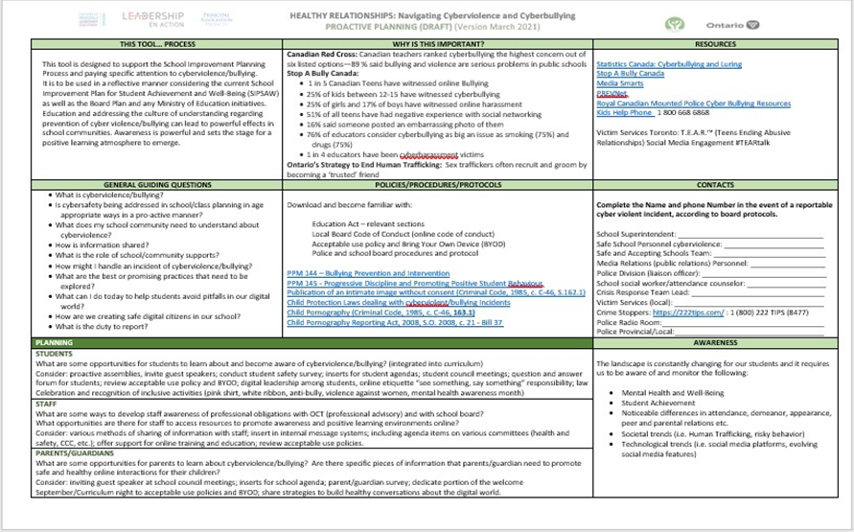
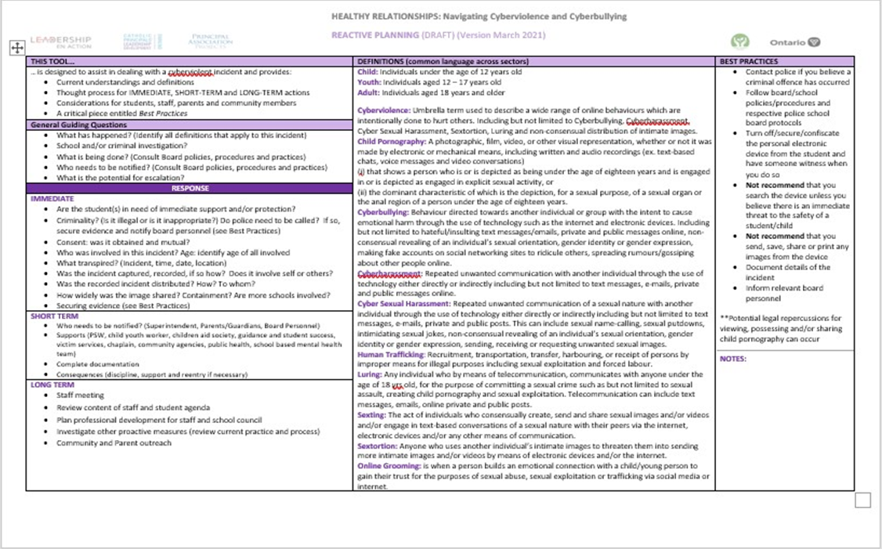
Proactive and Reactive Placemat Tools
Proactive Tool
Thought matrix for school planning
Reactive Tool
Thought matrix for responding to an incident
Notes:
It is suggested that you have a copy of the Proactive Placemat Tool printed for reference. The placemats prints best on “leger size” paper.

Slide 4
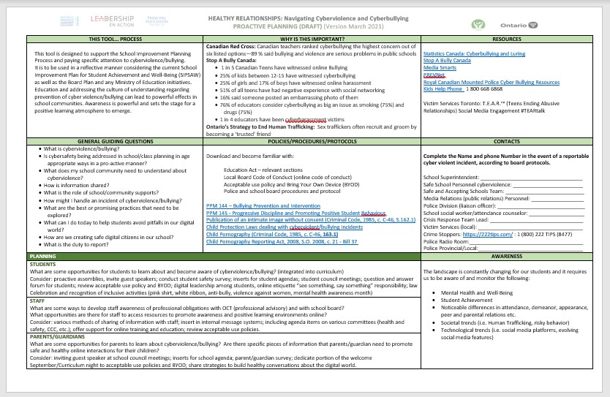
Proactive Placemat Tool
Proactive Tool – thought matrix for school planning
Notes:
This PPT will walk staff through the sections of the Proactive Placemat Tool. It is shared with staff as a reference point for thinking and/or with the Safe School Committee. Planning is prevention. Use of the Placemat Tool falls within the school planning cycle.

Slide 5
General Guiding Questions
What is cyberviolence/bullying?
Is cybersafety being addressed in school/class planning in age-appropriate ways in a pro-active manner?
What does my school community need to understand about cyberviolence?
How is information shared?
What is the role of school/community supports?
How might I handle an incident of cyberviolence/bullying?
What are the best or promising practices that need to be explored?
What can I do today to help students avoid pitfalls in our digital world?
How are we creating safe digital citizens in our school?
What is the duty to report?
Notes:
Reflective questions
These questions (conversation starters) could be used with school leaders and/or staff responsible for different grades, adapted as appropriate.

Slide 6
What is cyberviolence/bullying?
Suggested Activity: What do I know… what do I need to know?
Cyberviolence: Umbrella term used to describe a wide range of online behaviours which are intentionally done to hurt others. Including but not limited to Cyberbullying, Cyberharassment, Cyber Sexual Harassment, Sextortion, Luring and non-consensual distribution of intimate images.
Cyberbullying: Behaviour directed towards another individual or group with the intent to cause emotional harm through the use of technology such as the internet and electronic devices. Including but not limited to hateful/insulting text messages/emails, private and public messages online, nonconsensual revealing of an individual’s sexual orientation, gender identity or gender expression, making fake accounts on social networking sites to ridicule others, spreading rumours/gossiping about other people online.
Notes:
What is the difference between the two terms? A suggested activity initiates this inquiry with staff.
●These definitions play an integral part in navigating and understanding the varying nuances and thresholds of criminality of cyberbullying and cyberviolence situations and to develop common language across sectors.
●The term cyberviolence is umbrella term to describe the varying degrees of cyberviolence such as cyberbullying, cyberharassment, cybersexual harassment, distribution of intimate photos, child pornography, etc.
Use the next two slides of definitions with activities for staff to understand the definitions that are relevant and meaningful at age-appropriate levels.

Slide 7
DEFINITIONS
Child Pornography: A photographic, film, video or other visual representation, whether or not it was made by electronic or mechanical means, including written and audio recordings (ex. text based chats, voice messages and video conversations)(i) that shows a person who is or is depicted as being under the age of eighteen years and is engaged in or is depicted as engaged in explicit sexual activity, or(ii) the dominant characteristic of which is the depiction, for a sexual purpose, of a sexual organ or the anal region of a person under the age of eighteen years.
Cyberharassment: Repeated unwanted communication with another individual through the use of technology either directly or indirectly including but not limited to text messages, e-mails, private and public messages online.
Child: Individuals under the age of 12 years old
Youths: Individuals aged 12-17 years old
Adult: individuals aged 18 years and older
Notes:
NOTE: The ages of child, youth and adult are provided at the top for reference regarding determine criminal and individual involvement in incidents.
●The education and social service sector often label all negative online interactions as cyberbullying; however, it is very important to be able to identify the nuances in order to understand when an incident becomes criminal.
●For example, if there is one negative comment online this could be considered cyberbullying and goes against the school code of conduct. However, if the negative comments are ongoing and the individual has asked to not be contacted anymore and the behaviour continues, it could be considered harassment and therefore a chargeable offense and have stricter consequences.

Slide 8
DEFINITIONS
Sexual Harassment: Repeated unwanted communication of a sexual nature with another individual through the use of technology either directly or indirectly including but not limited to; text messages, e-mails, private and public posts. This can include: sexual name-calling, sexual putdowns, intimidating sexual jokes, non-consensual revealing of an individual’s sexual orientation, gender identity or gender expression, sending, receiving or requesting unwanted sexual images.
Human Trafficking: recruitment, transportation, transfer, harbouring, or receipt of persons by improper means for illegal purposes including sexual exploitation and forced labour.
Luring: Any individual who by means of telecommunication, communicates with anyone under the age of 18 years old, for the purpose of committing a sexual crime such as but not limited to sexual assault, creating child pornography and sexual exploitation. Telecommunication can include but is not limited to text messages, emails, online private and public posts.
Sexting: The act of individuals who consensually create, send and share sexual images and/or videos and/or engage in text-based conversations of a sexual nature with their peers via the internet, electronic devices and/or any other means of communication.
Sextortion: Anyone who uses another individual’s intimate images to threaten them into sending more intimate images and/or videos by means of electronic devices and/or the internet.
Online Grooming: is when a person builds an emotional connection with a child/young person to gain their trust for the purposes of sexual abuse, sexual exploitation or trafficking via social media or internet.
Notes:
Human trafficking is happening in schools throughout Ontario and majority of the recruitment happens through social media apps. This is something to be aware of as students are disclosing; there could potentially be a deeper issue going on.

Slide 9
Is cybersafety being addressed in school/class planning in age -appropriate ways in a proactive manner?
Suggested Activity: Today, as a snapshot in time, examine school documents (school plan, code of conduct, agenda etc.). How is CYBER SAFETY being addressed? Is there an area that needs to be improved upon? Are there more resources/supports required?
Notes:
Bring your school plan, school agendas, code of conduct for review.

Slide 10
What does my school community need to understand about cyberviolence?
Canadian Red Cross: Canadian teachers ranked cyberbullying the highest concern out of six listed options—89% said bullying and violence are serious problems in public schools
Stop A Bully Canada:
1 in 5 Canadian Teens have witnessed online Bullying
25% of kids between 12-15 have witnessed cyberbullying
25% of girls and 17% of boys have witnessed online harassment
51% of all teens have had negative experience with social networking
16% said someone posted an embarrassing photo of them
76% of educators consider cyberbullying as big an issue as smoking (75%) and drugs (75%)
1 in 4 educators have been victims of cyberharassment
Suggested Activity: Review the following statistics…what stands out for you? What stands out for our school community?
Ontario’s Strategy to End Human Trafficking: Sex traffickers often recruit and groom by becoming a ‘trusted’ friend.

Slide 11
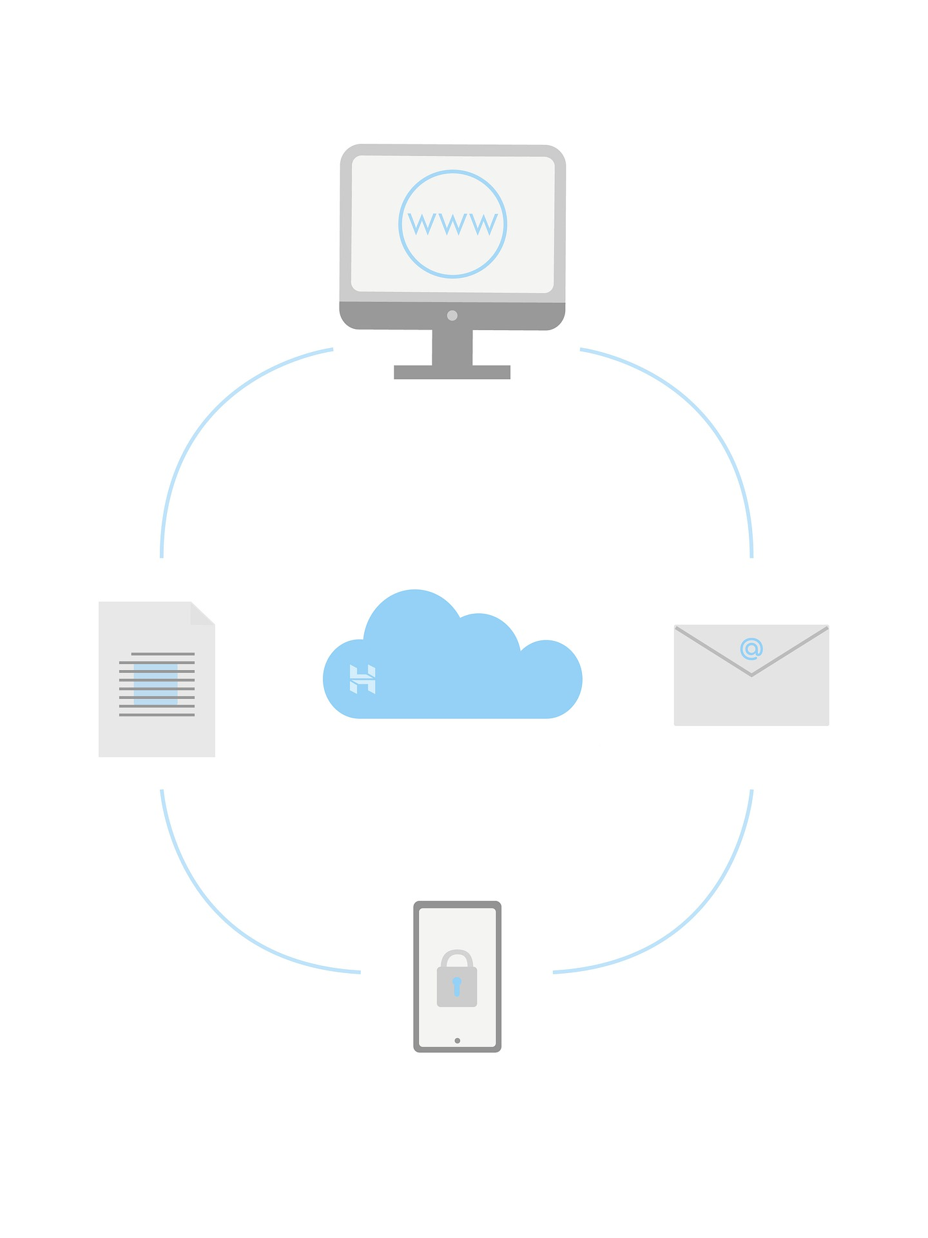
How is information shared?
Suggested Activity: Review current school practices for sharing information with students, staff and parents. Are there new methods we may wish to consider?
Notes:
Inquiry question for provocation.

Slide 12
What is the role of school/community supports?
Suggested Activity: Brainstorm the community supports available to us. What is their role in navigating cyberviolence and cyberbullying?
What is my role?
Suggested Activity: examine different documents…find out my responsibility within my role?
Notes:
VST have created a placemat for community connections for support…share Excel spreadsheet here.

Slide 13
How might I handle an incident of cyberviolence/bullying?
Suggested Activity: Working with a partner, discuss the steps that come to mind that need to be addressed when you are presented with an incident of cyberviolence and cyberbullying?
As a large group, debrief steps.
Notes:
This dialogue moves toward the reactive placemat.

Slide 14
What are the best or promising practices that need to be explored?
Suggested Activity: What best practices does our school community need to further investigate? …to build upon? …to initiate?
How might you take these practices to the next step?
Notes:
Based on response from the prior slide...what best practices does our school community need to further investigate? …to build upon? …to initiate?

Slide 15
What can I do today to help students avoid pitfalls in our digital world?
Suggested Activity: Are we aware of the digital world in which are students live? If so…what are the pitfalls? If we are not aware, how do we address this?
How do we find out the pitfalls? …suggestions???
Where is student voice? How do we balance leading and learning of our own knowledge?
Notes:
Where is student voice? How do we balance leading and learning of our own knowledge?
Does your current Student Voice Survey capture anything about cyberviolence and cyberbullying? Does it need to be updated?
Bring a copy of your student voice survey to review/discuss…are there any edits needed after this discussion?

Slide 16
How are we creating safe digital citizens in our school?
Suggested Activity: What supports are currently being offered to students, staff and parents?
What is a digitally responsible citizen? What is our role in digital citizenry?
Notes:
The principal associations have developed several resources that could be used with parent/guardians. See HR document that provides links to download these resources.

Slide 17
What is the duty to report?
Suggested Activity: What is the law? What is our duty within the law? What are our board’s Policies/Procedures/Protocols?
Education Act – relevant sections
Local Board Code of Conduct (online code of conduct)
Acceptable Use Policy and Bring Your Own Device (BYOD)
Police and School Board Procedures and Protocols
PPM 144 – Bullying Prevention and Intervention
PPM 145 - Progressive Discipline and Promoting Positive Student Behaviour
Publication of an intimate image without consent (Criminal Code, 1985, c. C-46, S.162.1)
Child Protection Laws Dealing with Cyberviolence/Bullying Incidents
Child Pornography (Criminal Code, 1985, c. C-46, 163.1)
Child Pornography Reporting Act, 2008, S.O. 2008, c. 21 - Bill 37
Notes:
Jigsaw each and share back to large group.

Slide 18
OUR MISSION
@adfo
@CPCOofficial
@OPCouncil
CONTACT US
ADFO www.adfo.org
CPCO www.cpco.on.ca
OPC www.principals.ca

