Slide 1
Healthy Relationships:
Navigating Cyberviolence and Cyberbullying
Toolkit: Reactive Placemat
(The information contained in these modules is meant to offer guidance regarding best practices to Principals and Vice-Principals in Ontario. Principals and Vice-Principals should always seek to consult with their board personnel and respect board directives and policy in regards to the management of incidents of cyberviolence and/or cyberbullying).
Notes:
This PowerPoint is to be used with school staff and is written through the lens of the Proactive Side of the Healthy Relationships Cyberbullying and Cyberviolence Placemat Tool.
Throughout the review of this PPT staff will:
Develop and understanding of the impact and growth of cyberviolence and cyberbullying in schools
This PowerPoint can be used as a school self-reflection tool to review: what is known, what is being done, what needs to be known and what need to be done in the future.
Identify the needs of staff, students and parents in learning about cyberviolence and cyberbullying.
This PPT is a guide for conversation with School Staff that allows users to identify the slides that best fit with the school and staff needs. Slides may be adapted for the school context
NOTE: This PPT is used after an incident has occurred. Review MFIPPA and everyone’s responsibility to protect the privacy of individuals, ALL employees of Ontario school boards who work with information have a responsibility to safeguard information in their care. Ensure Staff are aware of and adhere to MFIPPA, school board privacy policies and the Education Act and do not identify staff or student name(s), school or OEN within the discussion of any incidents or school planning or staff meetings.
(The information contained in these modules is meant to offer guidance regarding best practices to Principals and Vice-Principals in Ontario. Principals and Vice-Principals should always seek to consult with their board personnel and respect board directives and policy in regards to the management of incidents of cyberviolence and/or cyberbullying).

Slide 2



Our Partners
Funding provided by:
Notes:
This project is the result of a partnership between Leadership en action (ADFO), Catholic Principals’ Leadership Development (CPCO), Principal Association Projects (OPC) and Victim Services Toronto, funded by the Ministry of Education.

Slide 3
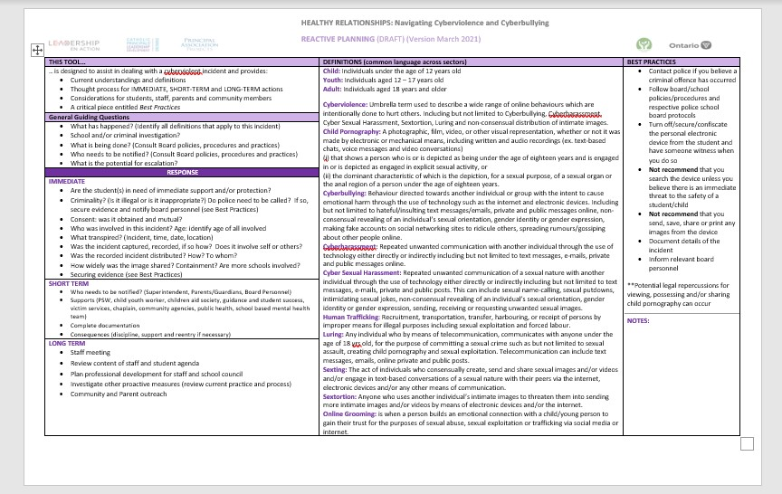
Reactive Placemat Tool
Part 2 Reactive Tool – thought matrix for administrators to respond to an incident
Notes:
This Reactive Placemat Tool is designed for school administrators when responding to an incident of cyberviolence or cyberbullying. It is shared with staff as a reference point for thinking.

Slide 4
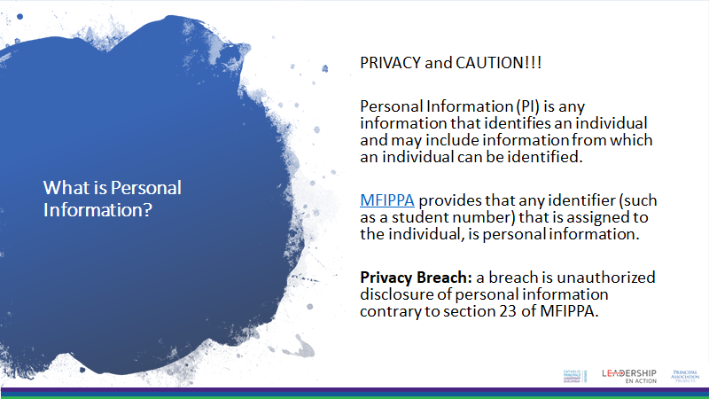
Notes:
NOTE: This PPT is used after an incident of cyberviolence or cyberbullying has occurred. Review your board’s policies/protocols/procedures regarding privacy and Information Management.
Municipal Freedom of Information and Protection of Privacy Act, R.S.O. 1990, c. M.56
(MFIPPA) Privacy: it is everyone’s responsibility to protect the privacy of individuals, ALL employees of Ontario school boards who work with information have a responsibility to safeguard information in their care. Ensure Staff are aware of and adhere to board policies/protocols/procedures and MFIPPA, and the Education Act.
Do NOT identify staff or student name(s), school or OEN within the discussion of any incidents or school planning or staff meetings.

Slide 5


General Guiding Questions for Administrators
Administrative Process:
Identify what has happened.
Determine if this is a school and/or criminal investigation.
What needs to be done (immediate, short-term, long-term)?
Who needs to be notified?
What is the potential for escalation?
What is the role of the school staff?
Notes:
The next few slides speaks to the administrative process for dealing with an incident. They are shared with staff for the purpose of understand the processes involved and for individual staff members to see themselves in this process…to think of what they need to become aware of…what they may need to do or how they may need to respond.
An incident of cyberviolence and/or cyberbullying has occurred.
Share with staff the administrative steps/process involved in dealing with the incident from the administrative perspective
What does a staff member need to know to deal with an incident? (immediate, short-term, long-term)?

Slide 6

Administrator RESPONSE: Immediate
Administrator Considerations:
  Are student(s) in need of immediate support and/or protection?
  Criminality?
  Consent?
  Who was involved?
  What transpired?
  Was the incident captured/recorded, if so how? Does it involve self or others?
  Was the recorded incident distributed, if so how? To whom?
  How widely was the image shared? Containment? Are there more schools involved?
  Securing evidence (see Best Practices)
Notes:
Continued

Slide 7

SEXTING
What is it?
How do you define it?
Notes:
An example that could be used to deepen understanding.
Popcorn out: these two questions…gather examples from staff…build a definition together, compare this to the definitions on the Placemat Tool. Support staff for whom this is new or disturbing information.

Slide 8
Administrator RESPONSE: Short Term
Administrator Considerations:
  Who needs to be notified?
  Supports available (PSW, Child Youth Worker, Catholic Children’s Aid Society, Guidance/Student Success, Victim Services, Chaplain, Community Agencies, Public Health, School-Based Mental Health Team)
  Complete documentation
  Consequences (discipline, support and re-entry if necessary)
Notes:
Continued

Slide 9
Administrator RESPONSE: Long Term
Administrator Considerations:
  Staff meeting
  Review content of staff and student agenda and current board practice and process
  Plan professional development for staff, students and school council
  Investigate other proactive measures
  Community and Parent outreach
Notes:
Continued

Slide 10
Administrative BEST PRACTICES
Contact police if you believe a criminal offence has occurred
Follow board/school policies/procedures and respective police school board protocols
Turn off/secure/confiscate the personal electronic device from the student and have someone witness when you do so
Document details of the incident
Inform relevant board personnel
It is NOT recommended:
that you search the device unless you believe there is an immediate threat to the safety of a student/child
that you send, save, share or print any images from the device
**Potential legal repercussions for viewing, possessing and/or sharing child pornography can occur **
Notes:
These suggested best practices apply to administration and staff members. Please note the highlighted comments and discuss the critical nature of understanding personal and professional vulnerability when dealing with the cyber world and your role in it.

Slide 11
HOW TO RESPOND?
Address
Address the uncomfortable nature to encourage the disclosure
Create
Create a safe trusting environment free of fear, hostility and judgment
Respond
Respond sensitively and appropriately to a disclosure – do not minimize
Trust
Trust your intuition
Notes:
In discussing with other administrators and staff who have had to deal with incidents in their schools, the comments are suggestions for all to keep in mind when responding to incidents.

Slide 12



WHAT TO DO?
REMEMBER THE INVESTIGATION WILL BE UNCOMFORTABLE GIVEN THE NATURE.
ALTHOUGH THE PRODUCTION OF SUCH IMAGERY WILL LIKELY TAKE PLACE OUTSIDE OF SCHOOL, THESE ISSUES OFTEN MANIFEST IN OUR BUILDINGS.
SCHOOL STAFF NEED TO BE ABLE TO RESPOND SWIFTLY AND CONFIDENTLY TO ENSURE THAT STUDENTS ARE SUPPORTED AND EDUCATED.
Notes:
Invite staff to add to this…

Slide 13

School Staff Considerations
Child Youth Family Services Act: Section 125 (duty to report neglect or abuse)
Recognizes the pressures of relationships
Discuss issues of consent and trust at age appropriate levels
Appropriate and acceptable boundaries
Privacy component of digital citizenship
Know there will be fallout (could last a long time)
Reassurance
Notes:
What is the role/responsibility for each and every staff member?
Suggestion to review the duty to report and board policies, procedures and protocols when responding to an incident.

Slide 14
Additional Thoughts…
Reach out to Community Agencies
Look for Curriculum Connections
Establish Social Justice-Like Clubs
Recognize Months/Days (November Bully Awareness Month and Prevention Week)
Invite Guest Speakers
Nurture Digital Citizenship
Foster Trusting School Climate
Consider adding questions to school climate student surveys
Notes:
This slide could be used as a proactive brainstorming session with staff for designing next steps.
What can WE do?

Slide 15

OUR MISSION
@adfo
@CPCOofficial
@OPCouncil
CONTACT US
ADFO www.adfo.org
CPCO www.cpco.on.ca
OPC www.principals.ca

